Slide 1
Advanced Software Engineering processes - Assignments
House of Quality
Testing
Code Review
Code Refactoring

Slide 2
House Of Quality - HOQ
Brief overview of what house of quality is.
A diagram resembling a house used to correlate customer desires to product capabilities.
HOQ is part of Quality function deployment, a planning matrix to relate what the customer wants to how the firm that produces products will handle these wants.

Slide 3
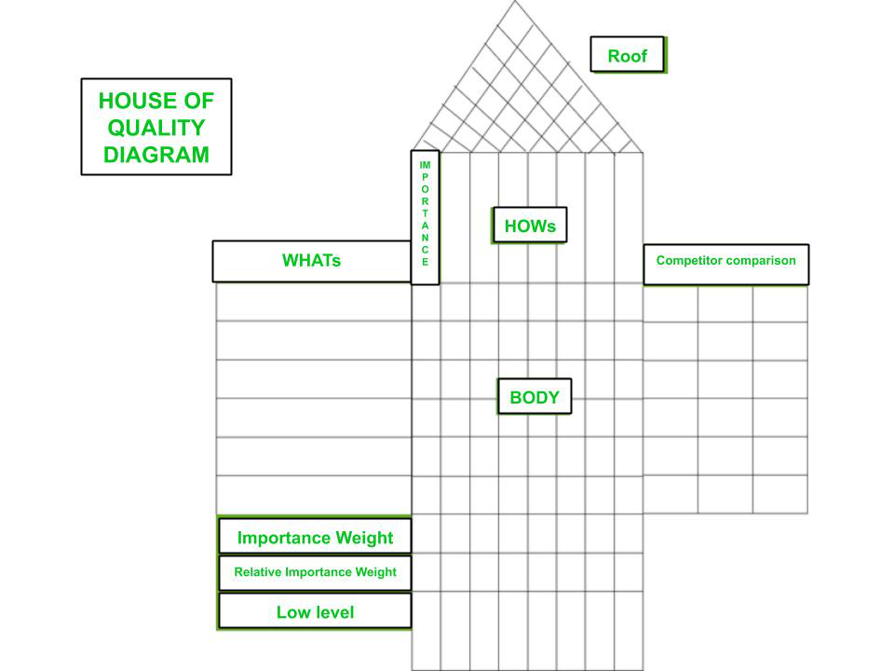

Slide 4
Beefed Rolex HOQ

Slide 5
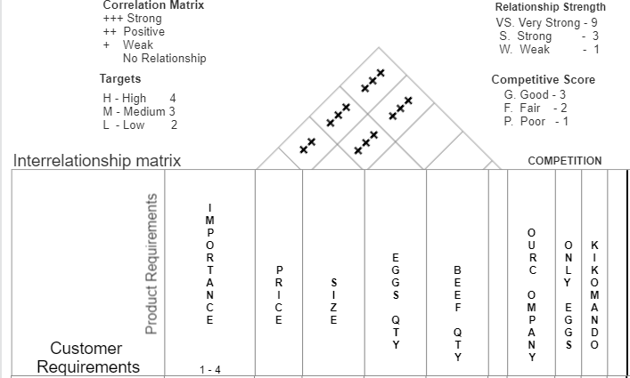

Slide 6
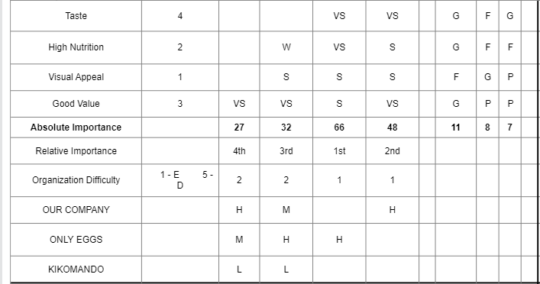
Price
Size
Eggs
Beef
5 -
TARGETS
H

Slide 7
Steps involved in Constructing a Beefed Rolex HOQ
Recording voice of the customer(their wants or needs)
Ranking the importance
Translate customer wants into the technical descriptors
Examine relationships between design between design and the customer requirements

